Slide 1
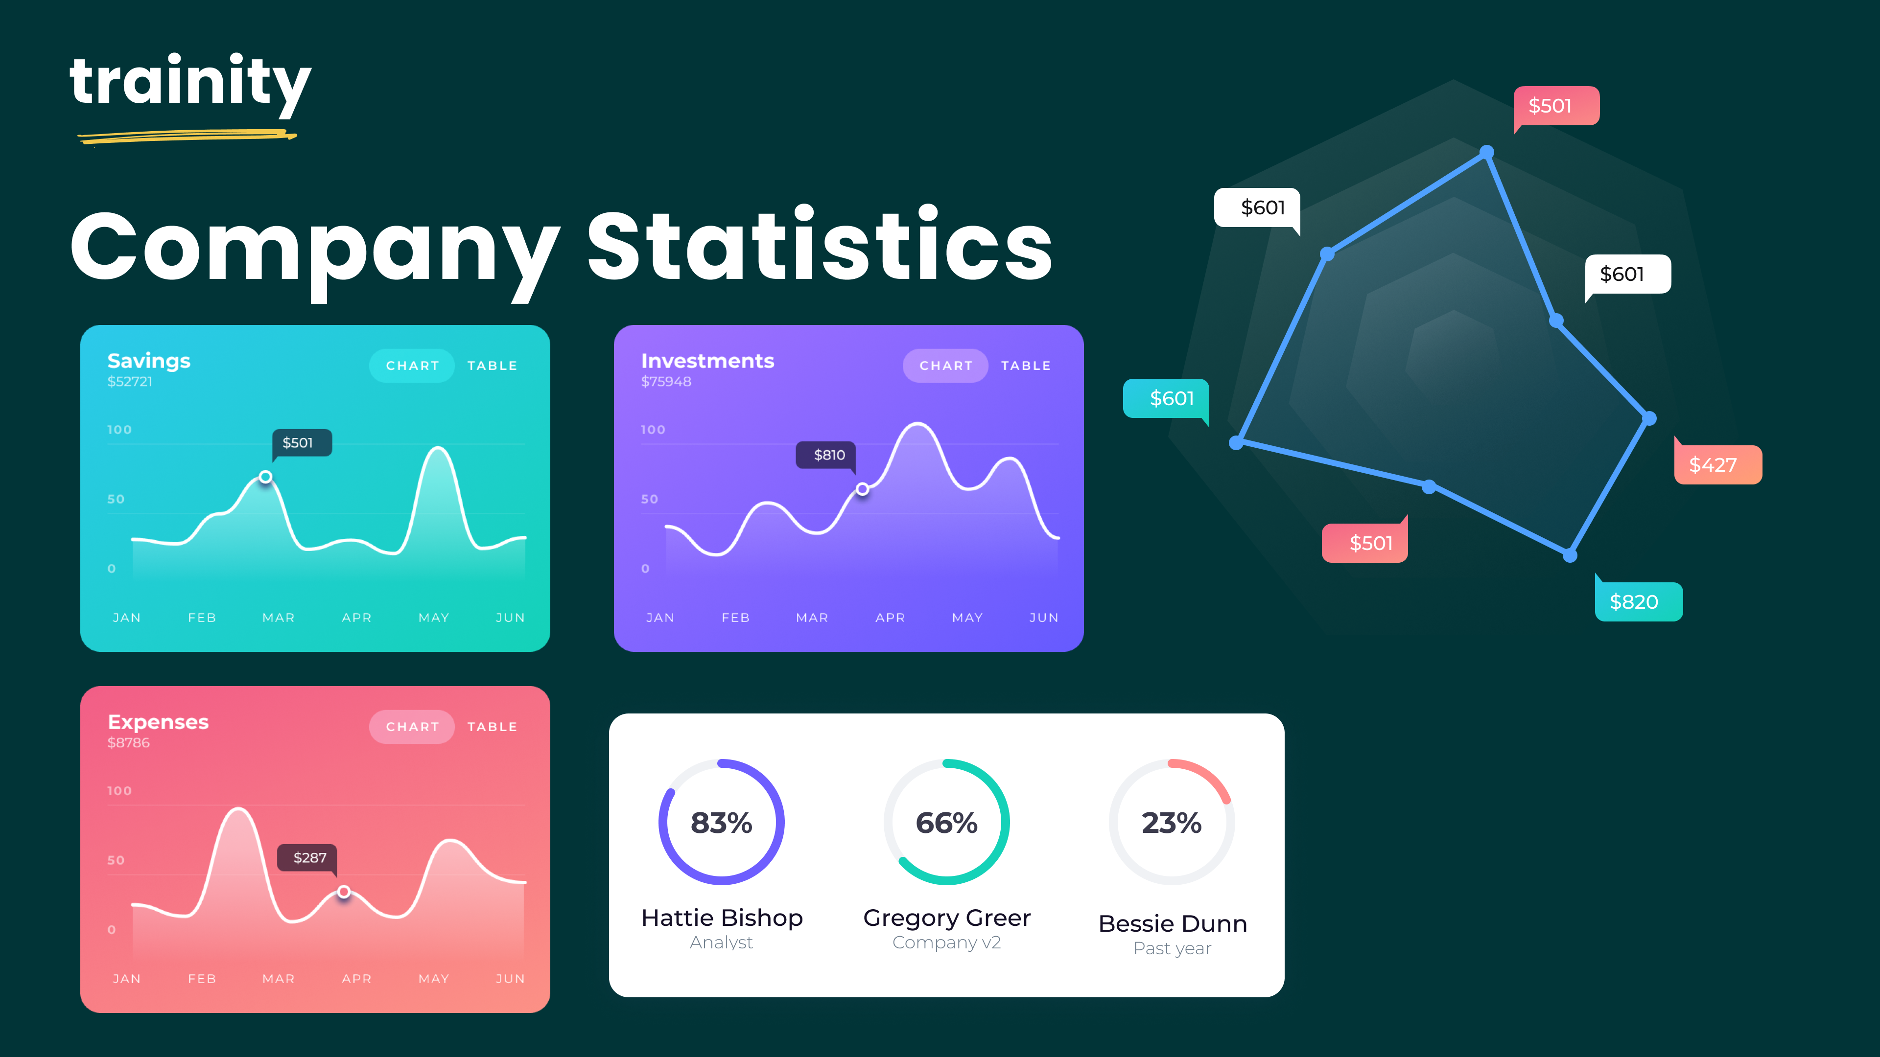
Hiring Process Analytics
Sumeet Dutta

Slide 2
Project Description
The aim is of this project is to analyze the company's hiring process data and draw meaningful insights from it. The hiring process is a crucial function of any company, and understanding trends such as the number of rejections, interviews, job types, and vacancies can provide valuable insights for the hiring department.

Slide 3
Objectives
Determine the gender distribution of hires. How many males and females have been hired by the company?
What is the average salary offered by this company? Use Excel functions to calculate this.
Create class intervals for the salaries in the company. This will help you understand the salary distribution.
Use a pie chart, bar graph, or any other suitable visualization to show the proportion of people working in different departments.
Use a chart or graph to represent the different position tiers within the company. This will help you understand the distribution of positions across different tiers.

Slide 4
Project Approach
This project involves organised approach including understanding the given data, checking for missing data, handling the missing data, clubbing columns with multiple categories to simplify the analysis, checking and removing the outliers in the data that may skey the analysis.

Slide 5
Tech-stack used
The tech-stack used for this project is Excel. Excel offers a wide range of function and tool for data analysis and manipulation, making it perfect for tasks such as data analysis and drawing insights from the dataset. Excel’s feature, such as function, formulae, tables, pivot tables and charts can be applied for data cleaning, calculating statistics, identifying trends, and visualizing data through charts and plots to better understand the data.

Slide 6
Hiring Analysis
Gender | No.
Male | 2561
Female | 1854
According to the provided data the company has hired 707 more males than females.

Slide 7
Salary analysis
Average Salary
49881.14312
The average salary in the company according to the provided data is 49,881.14312 rupees.

Slide 8
Salary distribution
Class Intervales | Frequency
0-20000 | 1405
20001-40000 | 1418
40001-80000 | 2961
80001-100001 | 1363
100001-500000 | 0
The majority of employee fall between the 40,001-80,000

Slide 9
Departmental Analysis
Proportion of Employee Working in Different Departments | Number of Employee
Finance Department | 176
General Management | 111
Human Resource Department | 70
Marketing Department | 201
Operations Department | 1840
Production Department | 246
Purchase Department | 230
Sales Department | 483
Service Department | 1326
Majority of employees work in Operation and Service Department

Slide 10
Position tier analysis
Post Name | Number of Employee
b9 | 461
c-10 | 231
c5 | 1742
c8 | 319
c9 | 1790
i1 | 220
i4 | 87
i5 | 785
i6 | 527
i7 | 979
m6 | 3
m7 | 1
n10 | 1
n6 | 1
n9 | 1
The highest proportion of employees are in the c5 post tier, after c5 are c9 and i7

Slide 11
Result
While working on this project I have accomplished several things. I have effectively analyzed the hiring data. Found the numbers of males and females hired in the company, calculated the average salary, created class intervals for the offered salary and visualized the data through bar graphs and pie chart to show the different position within the company.
This project provided me with valuable experience which helped me in enhancing my data analysis, statistical calculation and data visualization technique.
Dataset: https://docs.google.com/spreadsheets/d/1u5R_gndJHsn2mLQrh59xu5C8V722w7a6/edit?usp=sharing&ouid=100462539858177935973&rtpof=true&sd=true

Slide 12
Thank you

